Slide 1
Numerical Investigation of the Flow and Heat from two spheres in tandem arrangement
Do It by :
RAHMANI HAMZA
ZAIR AHMED EL AMINE

Slide 2
Introduction
The present study has numerically investigated two-dimensional flow (Axisymmetric) over two heated spheres in tandem arrangement
The Result of this investigation will describe a General behavior of the Flow by evaluating the Velocity streamline and Pressure, with different dimensionless parameter like Reynold number , and Drag Coefficient as same time we show the heat transfer problem and his effect to the flow

Slide 3
Problem Formulation
*Coupled Navier-Stock Equation:
Heat Equation :

Slide 4
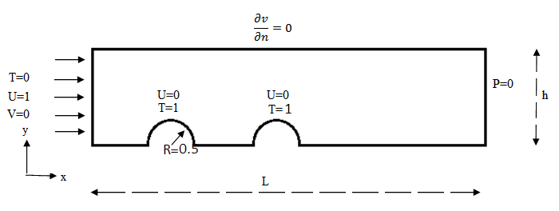
Boundary Condition

Slide 5
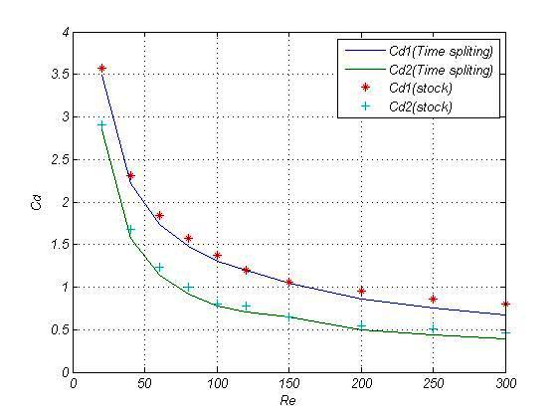
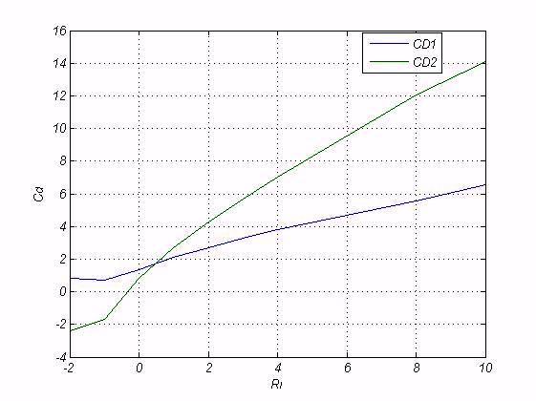
Result 1 : Drag coefficient

Slide 6
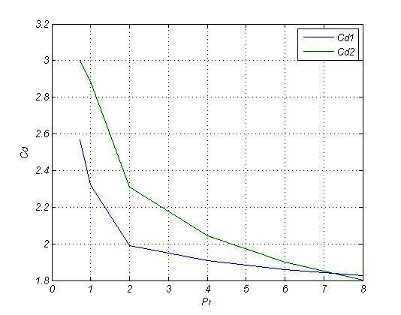
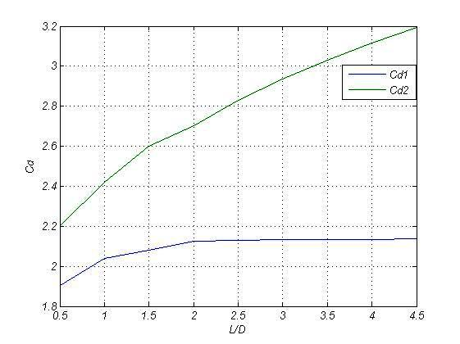
Drag Coefficient

Slide 7
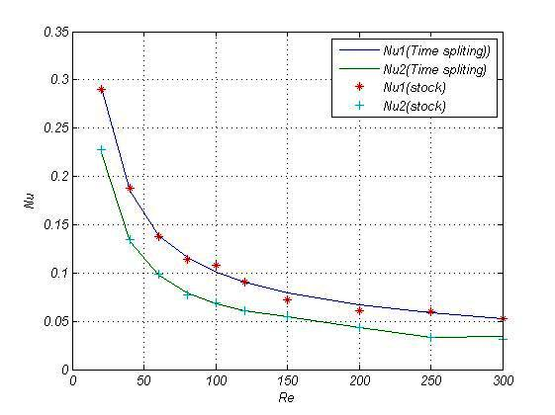
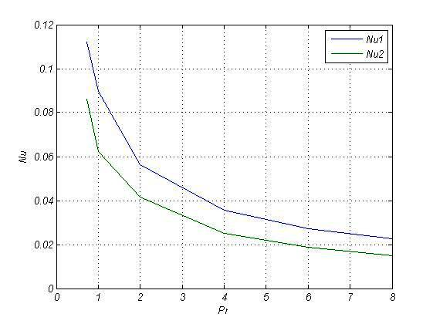
Nusselt Number
Le vecteur densité de courant thermique est :

Slide 8
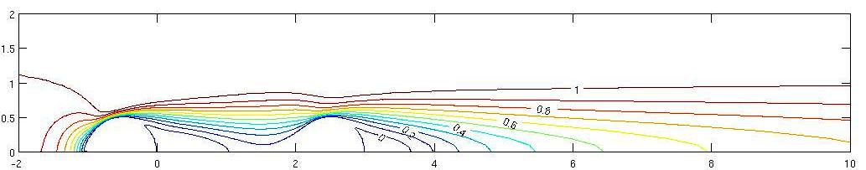
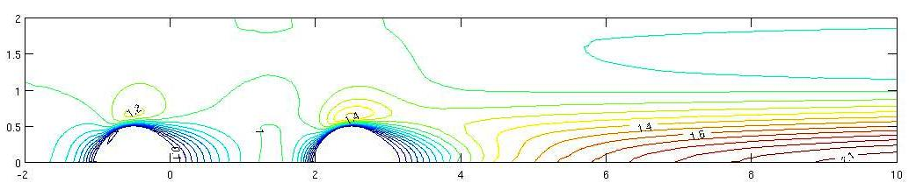
Velocity
Ri=0 ,Pr=0.72 ,Re=100
Ri=1 ,Pr=0.72,Re=100

Slide 9
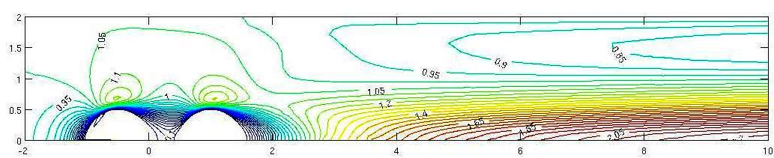
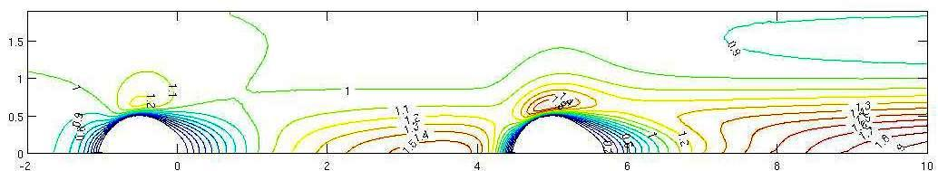
Velocity
Ri=1 ,Re=100 ,L/D =0.5
Ri=1,Re=100,L/D=4.5

Slide 10
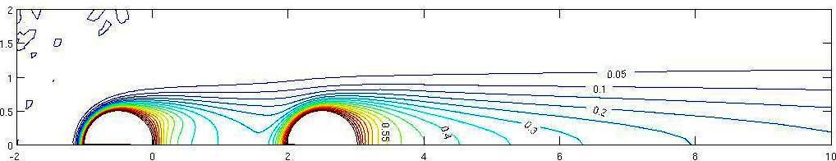
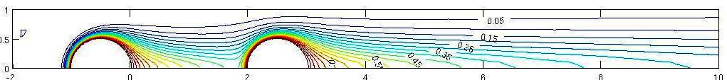
Temperature
Re=100 ,Ri=0,Pr=0.72
Re=100, Ri=1,Pr=0.72

Slide 11
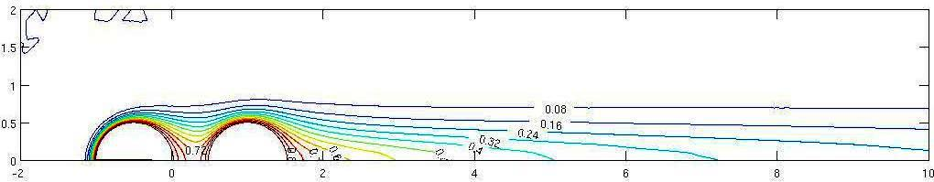
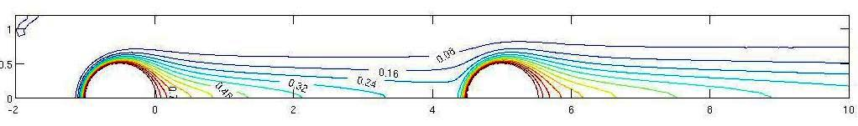
Temperature
Ri=1,Re=100,Pr=0.72,L/D=0.5
Ri=1,Re=100,Pr=0.72,L/D=4.5

Slide 12
Conclusion
At the end of our Project we can conclude :
The Study of Axisymmetric flow past two tendem spheres, can help us to obtain some prediciton about interaction between spheres
Determine the full model non dimensional parameter which influence the flow and the heat transfer like Nusselt number

